Slide 1
Deep learning project
Fashion MNIST Classification

Slide 2
Agenda
Concepts of Convolutional Neural Network?
Problem statement
Import Libraries
Load Data
Show Image from Numbers
Change Dimension / Feature Scaling
Build First Convolutional Neural Network
Train Model
Test & Evaluate Model
Confusion Matrix
Classification Report
Save Mode
Build 2 Complex CNN

Slide 3
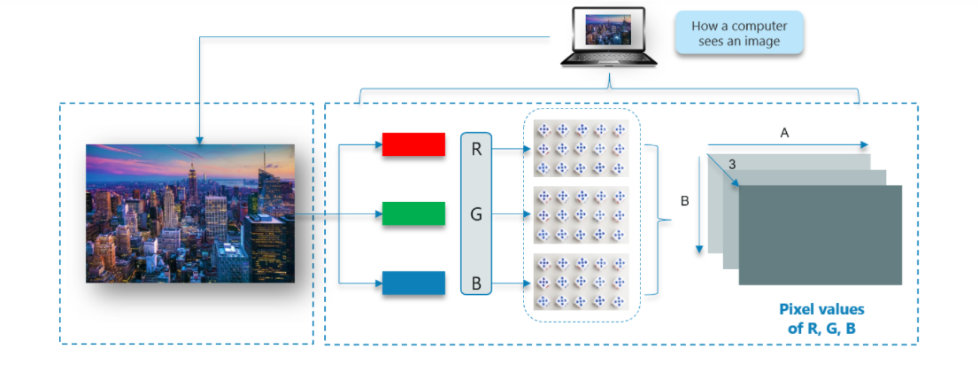
How does a computer read an image ?
The image is broken down into 3 color-channels which is Red, Green and Blue. Each of these color channels are mapped to the image’s pixel.
Then, the computer recognizes the value associated with each pixel and determine the size of the image.
For black-white images, there is only one channel and the concept is the same.

Slide 4
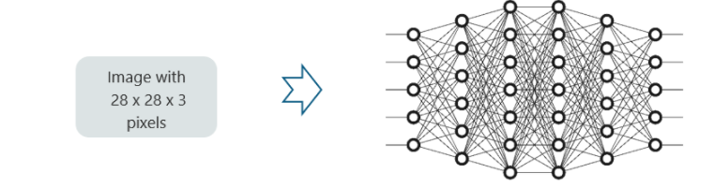
Why not fully connected Network
We cannot make use of fully connected networks when it comes to Convolutional Neural Networks, here’s why!
Consider the given image:
Here, wehave considered an input of images with the size 28x28x3 pixels. If we input this to our Convolutional Neural Network, we will have about 2352 weights in the first hidden layer itself.

Slide 5
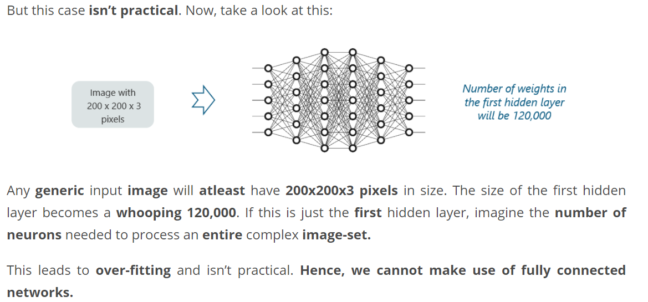
Why not fully connected network ?

Slide 6
What are CNN ?
Convolutional Neural Networks, like neural networks, are made up of neurons with learnable weights and biases. Each neuron receives several inputs, takes a weighted sum over them, pass it through an activation function and responds with an output.
The whole network has a loss function and all the tips and tricks that we developed for neural networks still apply on Convolutional Neural Networks.
Neural networks, as its name suggests, is a machine learning technique which is modeled after the brain structure. It comprises of a network of learning units called neurons.
These neurons learn how to convert input signals (e.g. picture of a cat) into corresponding output signals (e.g. the label “cat”), forming the basis of automated recognition.

Slide 7
CNN Example
Let’s take the example of automatic image recognition. The process of determining whether a picture contains a cat involves an activation function. If the picture resembles prior cat images the neurons have seen before, the label “cat” would be activated.
Hence, the more labeled images the neurons are exposed to, the better it learns how to recognize other unlabelled images. We call this the process of training neurons.

Slide 8
How CNN works ?
There are four layered concepts we should understand in Convolutional Neural Networks:
Convolution,
ReLu,
Pooling and
Full Connectedness (Fully Connected Layer).

Slide 9
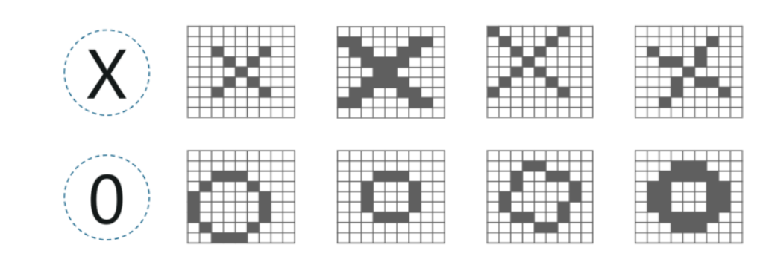
Example of CNN:
There are multiple renditions of X and O’s. This makes it tricky for the computer to recognize. But the goal is that if the input signal looks like previous images it has seen before, the “image” reference signal will be mixed into, or convolved with, the input signal. The resulting output signal is then passed on to the next layer.

Slide 10
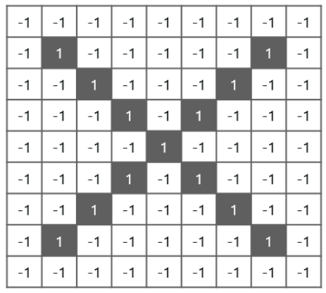
Example of CNN :
So the computer understands every pixel. In this case, the white pixels are said to be -1 while the black ones are 1. This is just the way we’ve implemented to differentiate the pixels in a basic binary classification.

Slide 11
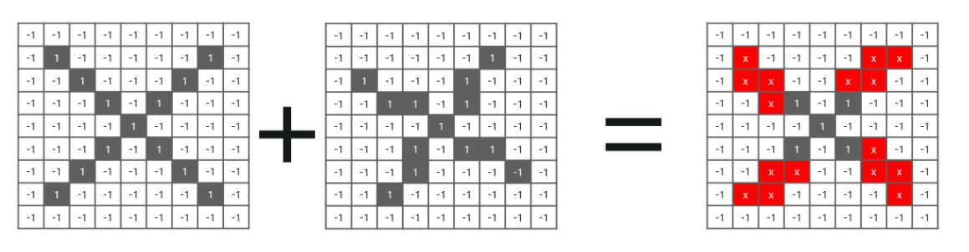
Example of CNN
Now if we would just normally search and compare the values between a normal image and another ‘x’ rendition, we would get a lot of missing pixels.

Slide 12
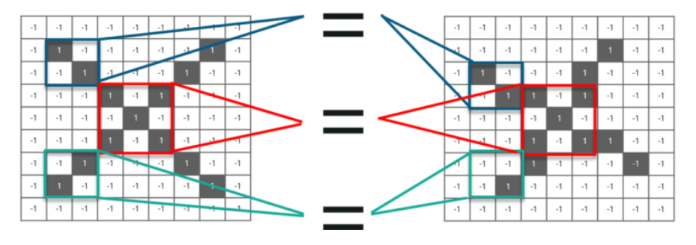
How do we fix the previous issue ?
We take small patches of the pixels called filters and try to match them in the corresponding nearby locations to see if we get a match. By doing this, the Convolutional Neural Network gets a lot better at seeing similarity than directly trying to match the entire image.

Slide 13
Convolution of an image
Convolution has the nice property of being translational invariant. Intuitively, this means that each convolution filter represents a feature of interest (e.g pixels in letters) and the Convolutional Neural Network algorithm learns which features comprise the resulting reference (i.e. alphabet).

Slide 14
4 steps for convolution
Line up the feature and the image
1
Multiply each image pixel by corresponding feature pixel
2
Add the values and find the sum
3
Divide the sum by the total number of pixels in the feature
4

Slide 15
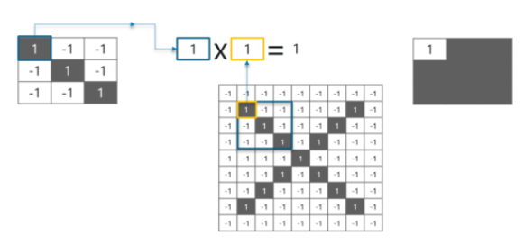
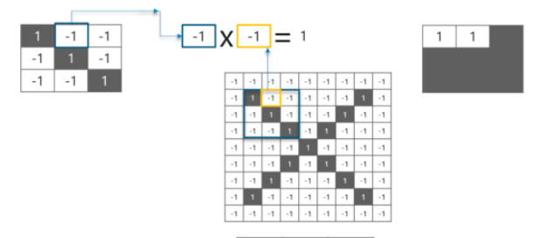
Step 1 and 2

Slide 16
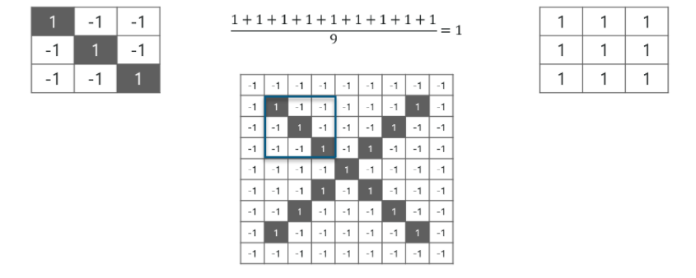
Step 3 and 4

Slide 17
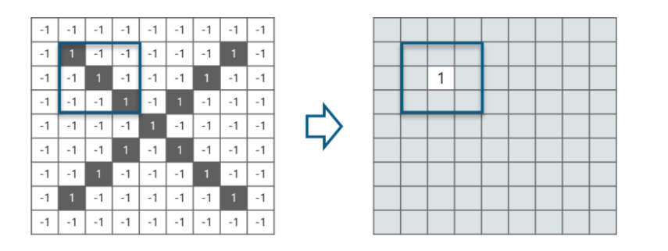
Put the value in center

Slide 18
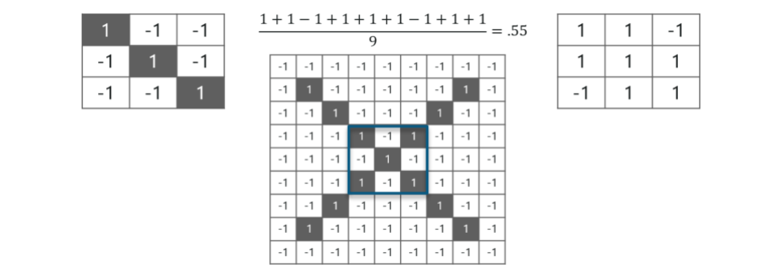
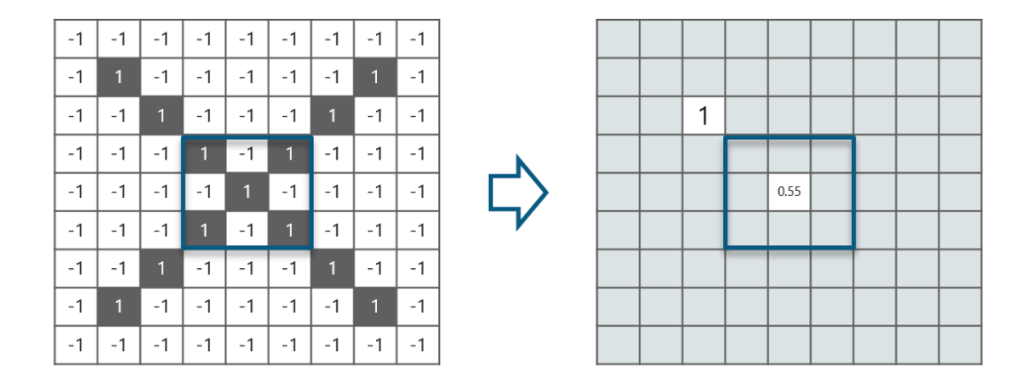
One more example
Now, we can move this filter around and do the same at any pixel in the image. For better clarity, let’s consider another example:As you can see ,here after performing first four steps we have value of 0.55

Slide 19
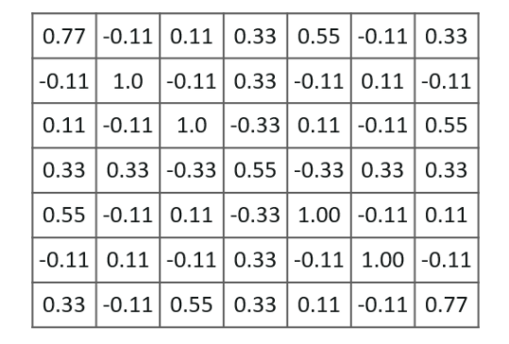
Next step
Similarly, we move the feature to every other position in the image and see how the feature matches that area. So after doing this, we will get the output as:
Here we considered just one filter. Similarly, we will perform the same convolution with every other filter to get the convolution of that filter.
The output signal strength is not dependent on where the features are located, but simply whether the features are present. Hence, an alphabet could be sitting in different positions and the Convolutional Neural Network algorithm would still be able to recognize it.

Slide 20
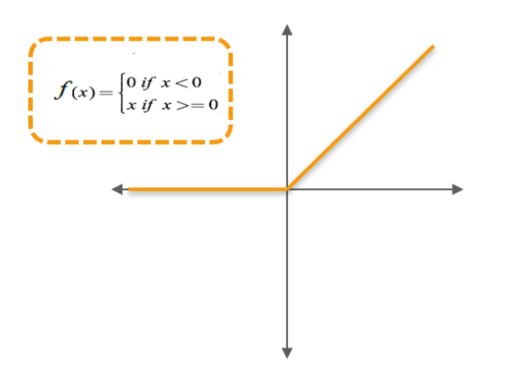
Relu Layer
ReLU is an activation function. But, what is an activation function?
Rectified Linear Unit (ReLU) transform function only activates a node if the input is above a certain quantity, while the input is below zero, the output is zero, but when the input rises above a certain threshold, it has a linear relationship with the dependent variable.

Slide 21
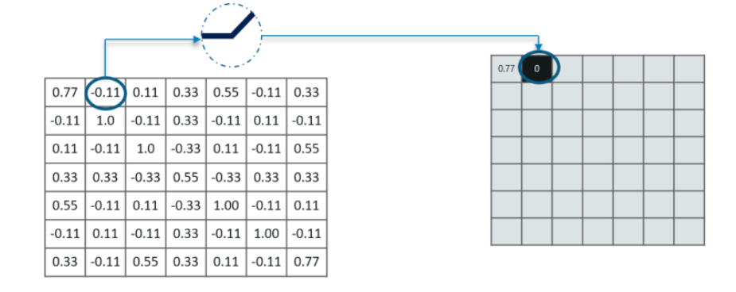
Why do we require Relu here ?
The main aim is to remove all the negative values from the convolution. All the positive values remain the same but all the negative values get changed to zero as shown in the image :

Slide 22
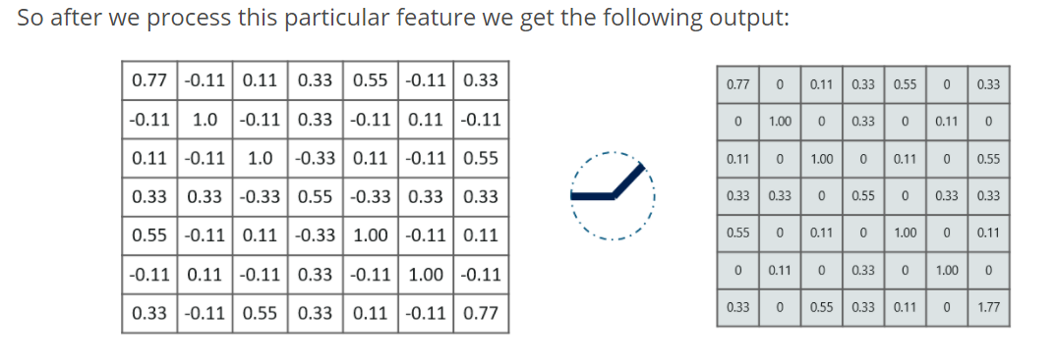
Relu layer

Slide 23
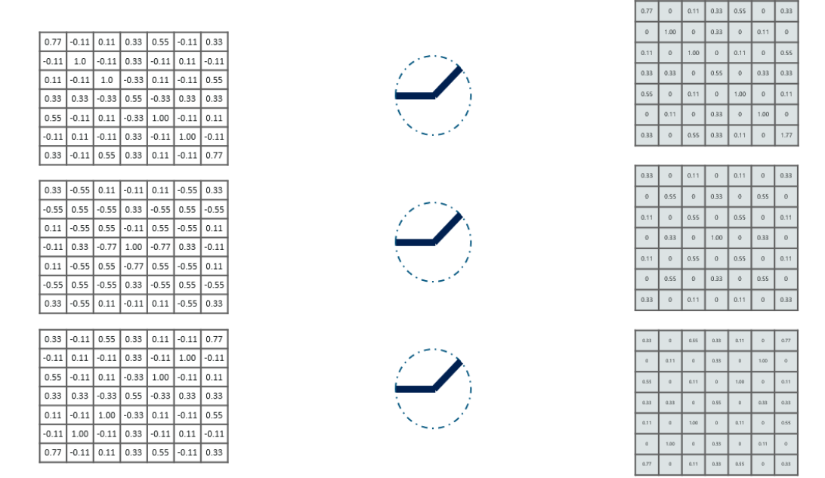
Relu layer
similarly we do the same process to all the other feature images as well

Slide 24
Pooling layer
In this layer we shrink the image stack into a smaller size. Pooling is done after passing through the activation layer. We do this by implementing the following 4 steps:
Pick a window size (usually 2 or 3)
Pick a stride (usually 2)
Walk your window across your filtered images
From each window, take the maximum value

Slide 25
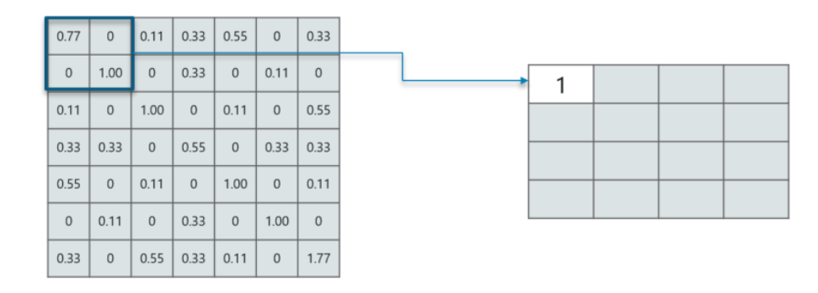
Pooling layer example
Consider performing pooling with a window size of 2 and stride being 2 as well.
So in this case, we took window size to be 2 and we got 4 values to choose from. From those 4 values, the maximum value there is 1 so we pick 1. Also, note that we started out with a 7×7 matrix but now the same matrix after pooling came down to 4×4.

Slide 26
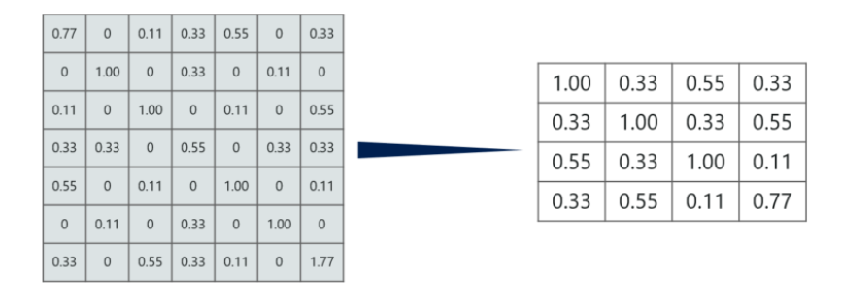
Pooling layer example
But we need to move the window across the entire image. The procedure is exactly as same as above and we need to repeat that for the entire image.

Slide 27
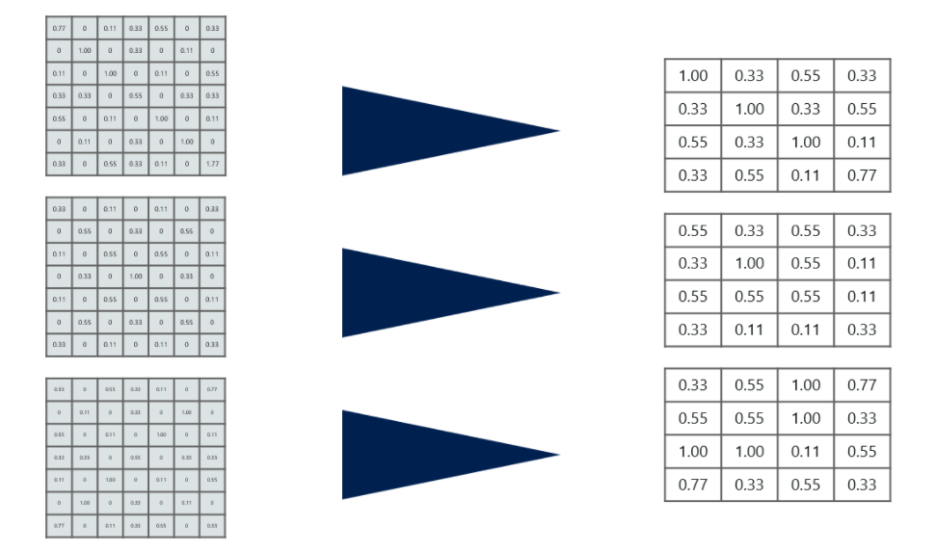
Pooling layer example
Do note that this is for one filter. We need to do it for 2 other filters as well. This is done and we arrive at the following result:

Slide 28
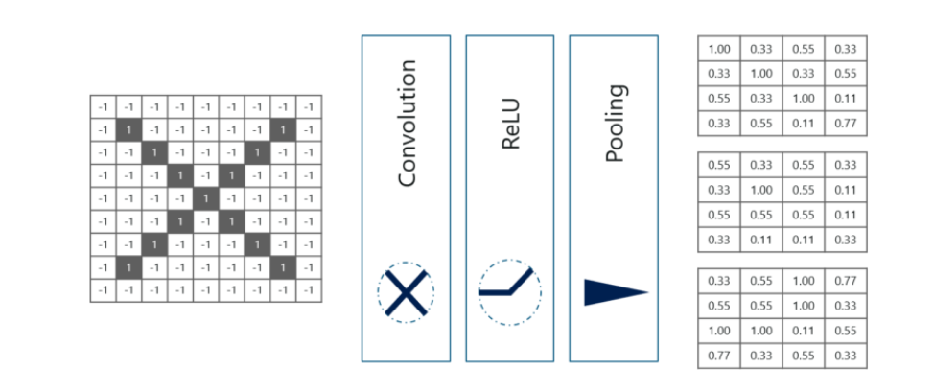
Stacking up all the layers
So to get the time-frame in one picture we’re here with a 4×4 matrix from a 7×7 matrix after passing the input through 3 layers – Convolution, ReLU and Pooling as shown in the image:

Slide 29
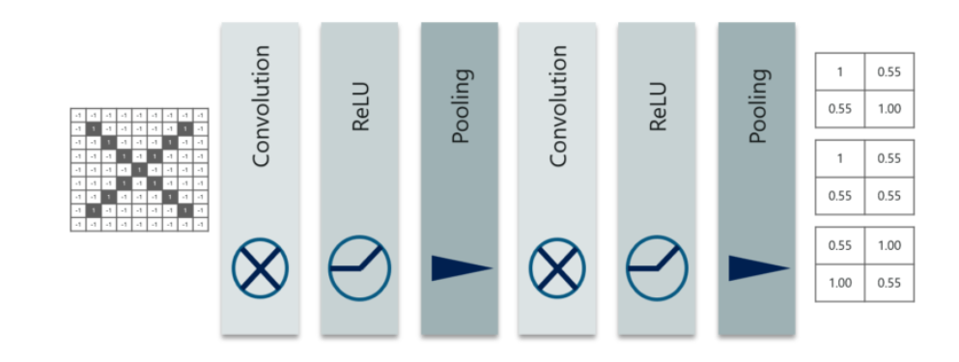
Iteration of the same operation
So after the second pass we arrive at a 2×2 matrix as shown:

Slide 30
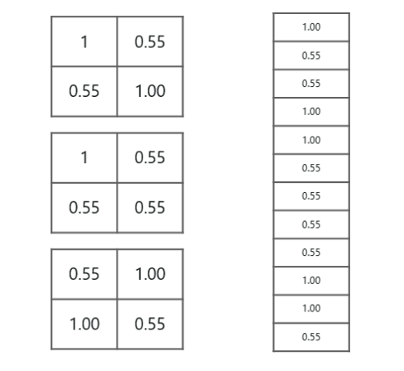
Next step
The last layers in the network are fully connected, meaning that neurons of preceding layers are connected to every neuron in subsequent layers.
This mimics high level reasoning where all possible pathways from the input to output are considered.
Also, fully connected layer is the final layer where the classification actually happens. Here we take our filtered and shrinked images and put them into one single list as shown :

Slide 31
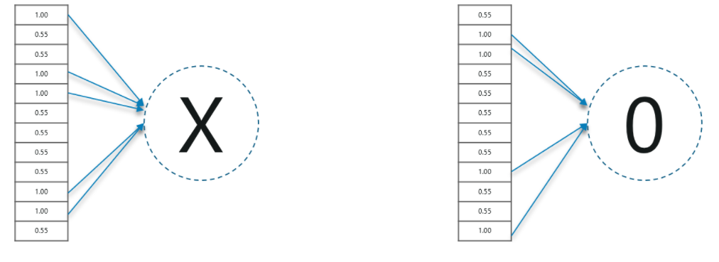
Next step
when we feed in, ‘X’ and ‘O’ there will be some element in the vector that will be high. Consider the image below, as you can see for ‘X’ there are different elements that are high and similarly, for ‘O’ we have different elements that are high:
When the 1st, 4th, 5th, 10th and 11th values are high, we can classify the image as ‘x’. The concept is similar for the other alphabets as well – when certain values are arranged the way they are, they can be mapped to an actual letter or a number which we require

Slide 32

Testing of CNN
We have a 12 element vector obtained after passing the input of a random letter through all the layers of our network.
But, how do we check to know what we’ve obtained is right or wrong?
We make predictions based on the output data by comparing the obtained values with list of ‘x’and ‘o’!

Slide 33
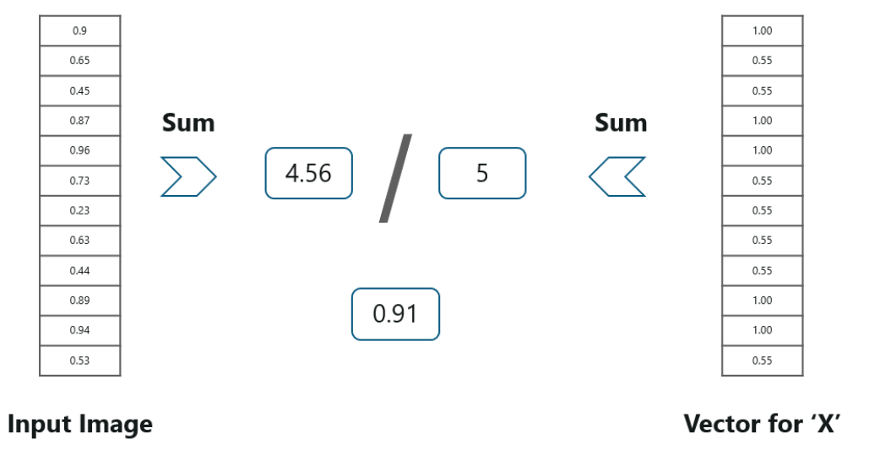
Testing of CNN
We just added the values we which found out as high (1st, 4th, 5th, 10th and 11th) from the vector table of X and we got the sum to be 5. We did the exact same thing with the input image and got a value of 4.56.
When we divide the value we have a probability match to be 0.91!

Slide 34
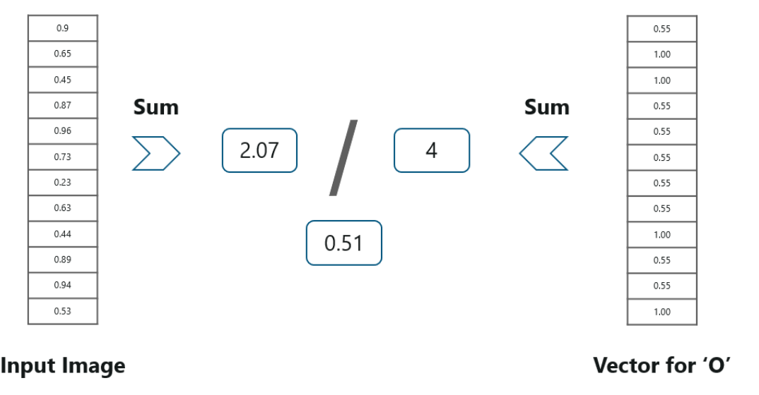
Testing of CNN
We have the output as 0.51 with this table. Well, probability being 0.51 is less than 0.91, isn’t it?
So we can conclude that the resulting input image is an ‘x’!

Slide 35
Problem statement
The objective is to identify (predict) different fashion products from the given images using Convolutional neural network.
The ‘target’ dataset has 10 class labels, as we can see from above (0 – T-shirt/top, 1 – Trouser,,….9 – Ankle Boot).
Given the images of the articles, we need to classify them into one of these classes, hence, it is essentially a ‘Multi-class Classification’ problem.

Slide 36
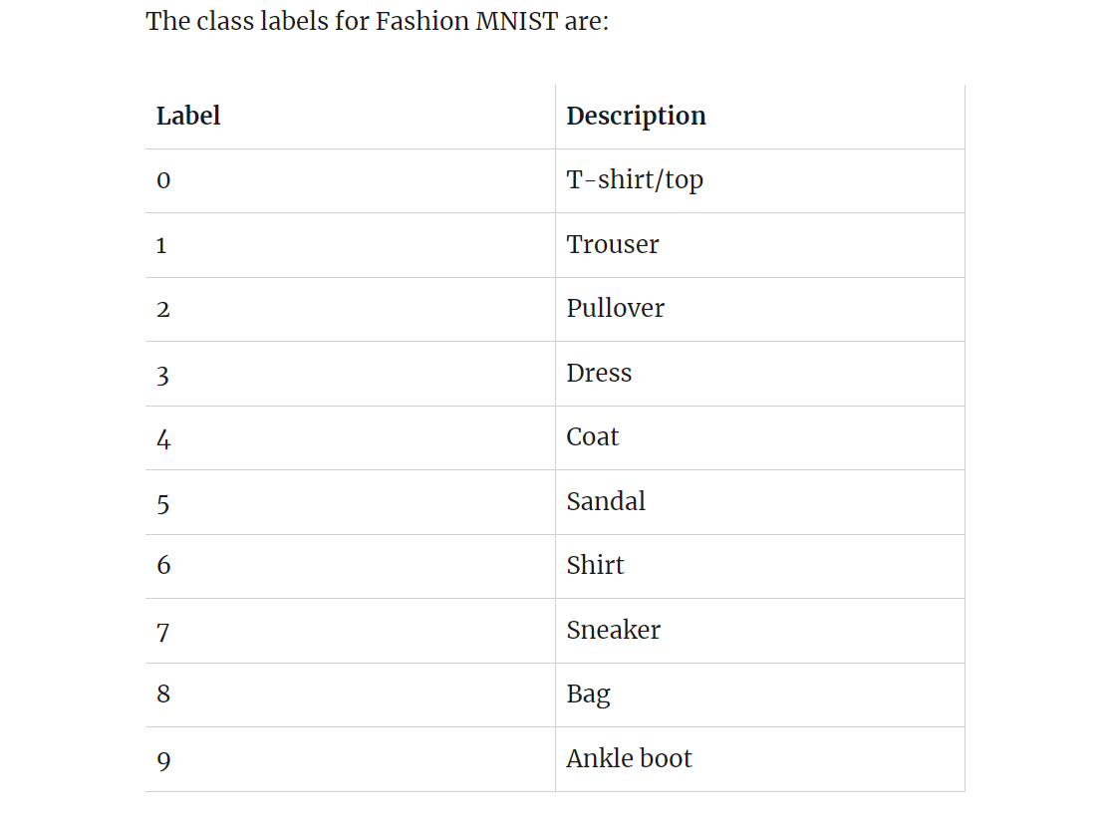
Understanding the Dataset
Fashion MNIST Training dataset consists of 60,000 images and each image has 784 features (i.e. 28×28 pixels). Each pixel is a value from 0 to 255, describing the pixel intensity. 0 for white and 255 for black.

Slide 37
Data Preprocessing
Import Libraries
1
Load Data
2
Show Image from Numbers
3
Change Dimension / Feature Scaling
4

Slide 38
Build CNN
Model building by convolutional neural network.

Slide 39
Test and evaluate model
Test & Evaluate Model
Confusion Matrix
Classification Report

Slide 40
Build 2 complex CNN
Including more hidden layers and test it.

Slide 41
The End
Thank you

